Slide 1
Group Project 1
CS 331
Sep. 26. 2019 - Oct. 22. 2019
Group Members
Serena Burton
Jerry Chacha
Thomas Jimenez
Jianguo Jin
Steven Marmolejo
Mudit Prashar

Slide 2
Team Contributions
Serena Burton – Video
Jerry Chacha – Meeting Notes
Thomas Jimenez – JDBC, Todo Documentation
Jianguo Jin – Presentation
Steven Marmolejo – Project Leader
Mudit Prashar – Project Manager

Slide 3
Group Meeting Agenda
Project was laid out for team members
Roles were assigned to group members
First few meetings were for query completion
Project planner was set ahead so group members could finish first 10 queries by a certain date, then next 10
We created a team chat so that members that couldn’t attend could stay informed of progress
After query completion we met again to choose our best and worst queries and voted as a group on which queries to be selected for presentation
Before project completion we met as group to make the recordings and sync them with our presentation

Slide 4
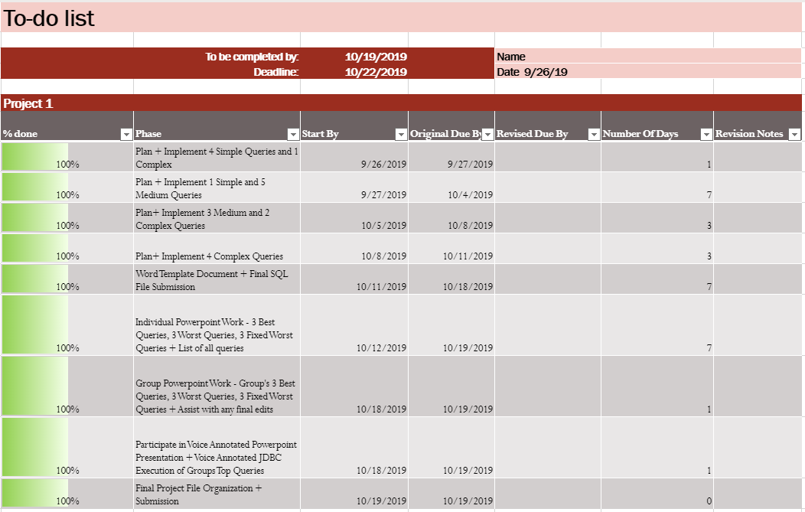
Todo List Documentation
The phases were divided by the following:
Plan + Implement different queries incrementally
Creating our Project Word Template Document and Final SQL File with all 20 Queries
Adding our 9 individual slides to the group presentation (3 top, 3 worst and 3 fixed queries)
Creating our group presentation based on our powerpoint and jdbc execution
Final file organization for submission
The todo list for group members only changed if:
A particular member had a additional responsibility (i.e. creating a java application for jdbc execution, slides on the powerpoint that were not based on individual efforts)

Slide 5
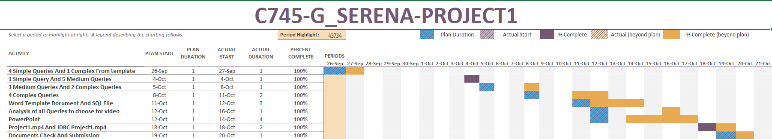
Project Plan Documentation
Project Planner was set after the first meeting.
Each activity serves as task all the member in the team has to do or contribute to.
Project planner helped laying out the structure for the project and break it down in parts.
Plan Date and Plan duration was set in advance.

Slide 6
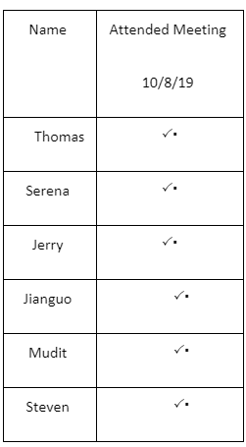
Attendance
We had 5 face to face group meetings
Each member had a task to complete before the upcoming meeting
These meetings were useful if we had any questions or puzzled during a task
These meetings would last around 3 hours each
We also had one online voice conference

Slide 7
Notable Team Effort
Thomas: Responsible for the JDBC and To do list.
Mudit: Responsible for the Project Planner
Serena: Responsible for editing video files for powerpoint
Jerry: Responsible for keeping attendance and agenda notes
Jianguo: Responsible for formatting queries and revising powerpoint
Steven: Responsible for assigning tasks to team members

Slide 8
Individual Assessment
Serena Burton

Slide 9
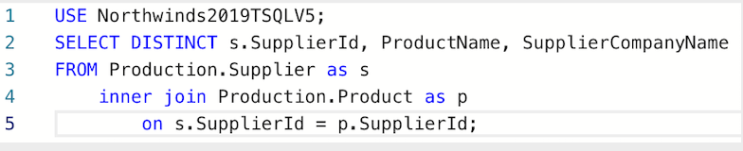
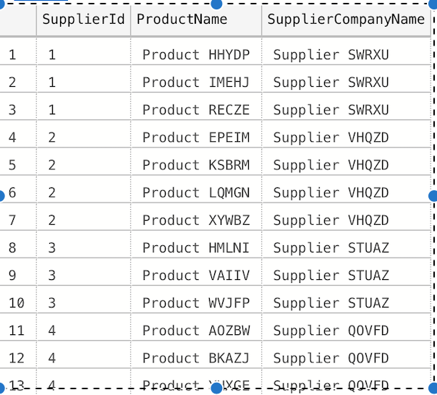
Individual Assessment - Top 3 Problems
Group Member: Serena Burton
Problem Type: Simple
Top Problem #1
Problem #1: List all supplier companies and the products they supply
Why did I choose this problem for top rating?
It makes searching for where to buy certain products more convenient.
Comparing the products different companies supply will be much easier.
Query:
Sample Output:

Slide 10
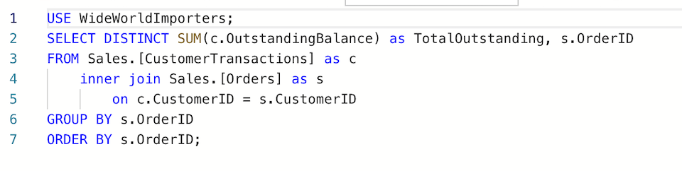
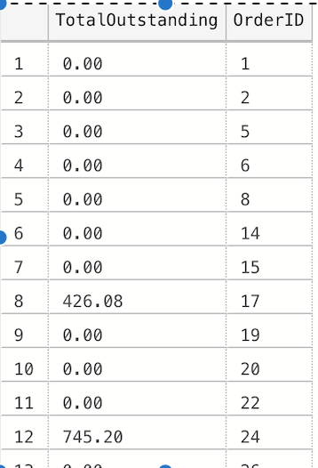
Individual Assessment - Top 3 Problems
Group Member: Serena Burton
Problem Type: Medium
Top Problem #2
Problem #9: Find the total outstanding balance for customers and their order IDs.
Why did I choose this problem for top rating?
Businesses can keep track of the customers who have outstanding balances.
Businesses can filter customers according to their balance with a simple WHERE statement
Query:
Sample Output:

Slide 11
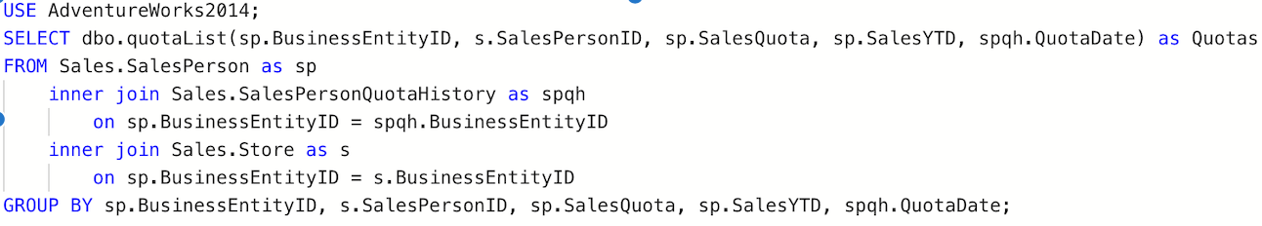
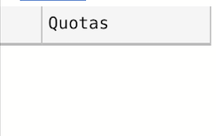
Individual Assessment - Top 3 Problems
Group Member: Serena Burton
Problem Type: Hard
Top Problem #3
Problem #19: List salespersons' business entity IDs, their sales person ID, the amount of money they need to make to meet their quota, and the time left to meet the quota.
Why did I choose this problem for top rating?
Salespersons can easily access information regarding their quota and work accordingly
Provides due dates and tracks the amount of money needed to be made
Query:
Sample Output:

Slide 12
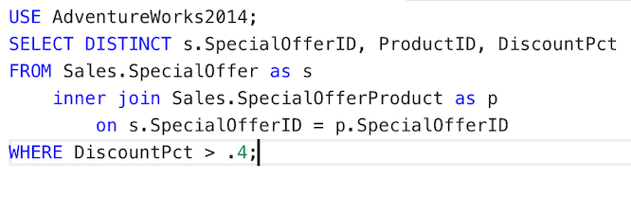
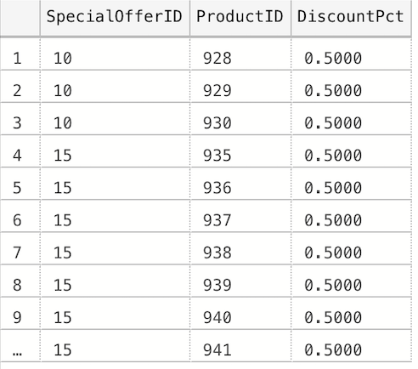
Individual Assessment - Worst 3 Problems
Group Member: Serena Burton
Problem Type: Simple
Worst Problem #1
Problem #4: List the product IDs of items with a discount percentage greater than .4
Why did I choose this problem for worst rating?
It is an oddly specific discount percentage to be looking for
Individuals will not know the product name associated with the product ID.
Query:
Sample Output:

Slide 13
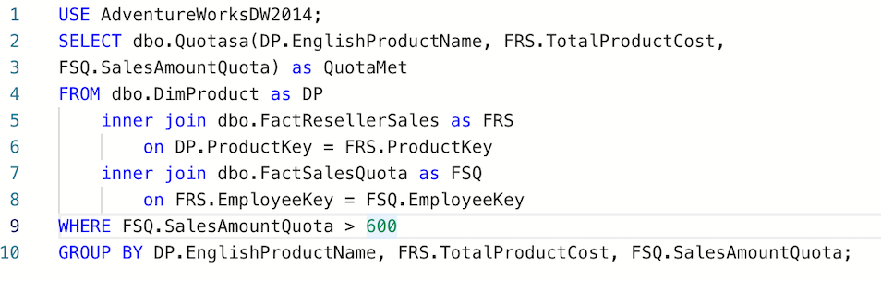
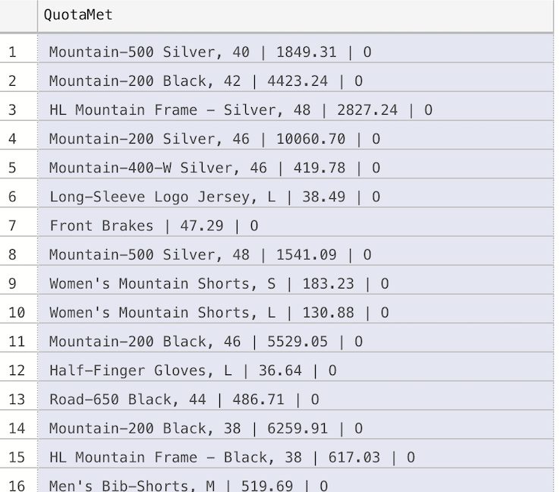
Individual Assessment - Worst 3 Problems
Group Member: Serena Burton
Problem Type: Medium
Worst Problem #1
Problem #10: Find the total unit price of products after their discount and the number of months this discount is available
Why did I choose this problem for worst rating?
Individuals will not know which months the discount is available
Query:
Sample Output:

Slide 14
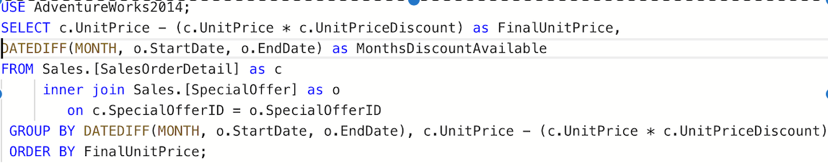
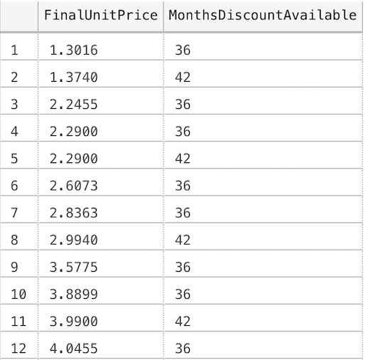
Individual Assessment - Worst 3 Problems
Group Member: Serena Burton
Problem Type: Hard
Worst Problem #1
Problem #17: All products have a sales quota of $600 or more
List product names, their total product cost, and write 'O' if the quota was met or 'X' if the quota was not met
Why did I choose this problem for worst rating?
Different products have different prices therefore quotas should be different for each item.
‘X’s and ‘O’s can be a confusing way of declaring whether or not the quota was met for a certain item
Query:
Sample Output:

Slide 15
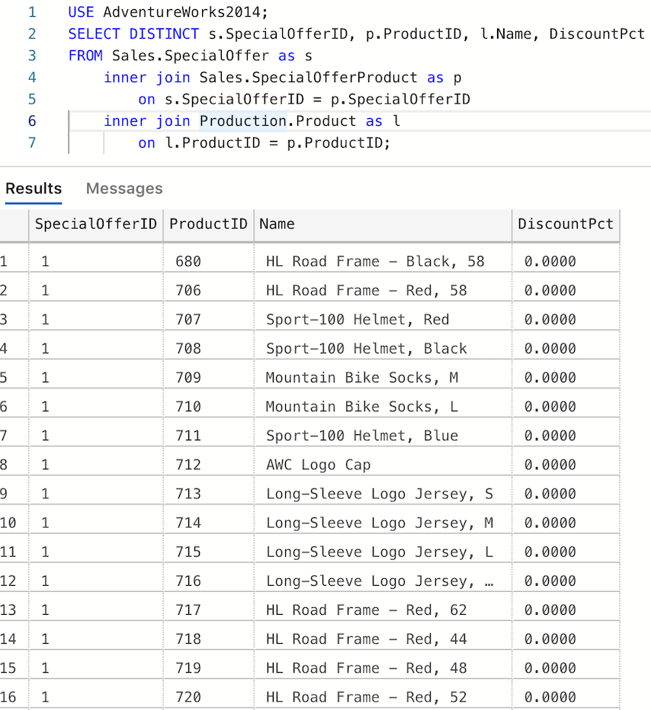
Individual Assessment - Fixed Worst 3 Problems
Group Member: Serena Burton
Problem Type: Simple
Worst Problem #1
Problem #4: List the product IDs of items with a discount percentage greater than .4
What did I change to fix this query?
The names of the discounted products are now listed.
Removed the requirement for the discount to be greater than 40%
How did this improve my query?
It is now easier to understand specifically which product is discounted
The query can now be changed to search for any discount percentage.
Query & Output:

Slide 16
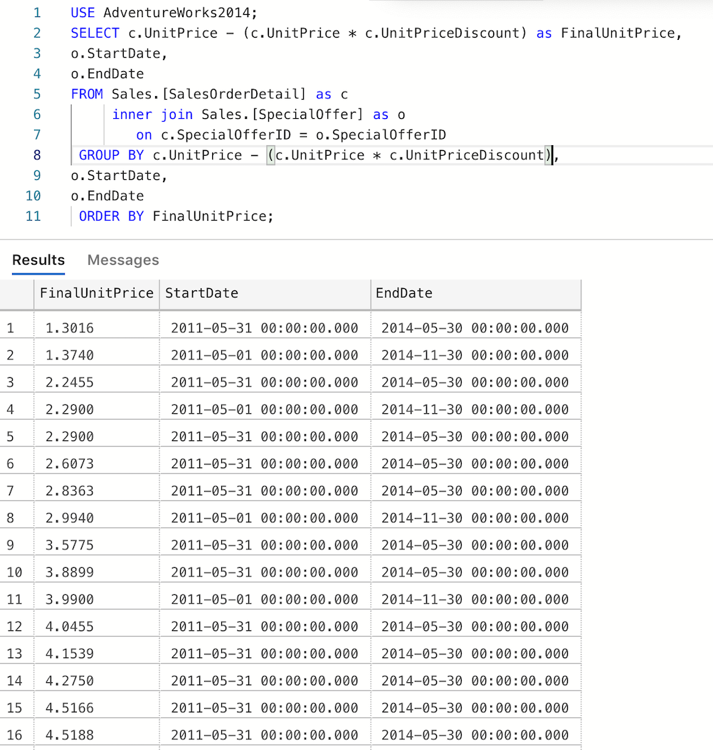
Individual Assessment - Fixed Worst 3 Problems
Group Member: Serena Burton
Problem Type: Medium
Worst Problem #1
Problem #10: Find the total unit price of products after their discount and the number of months this discount is available
What did I change to fix this query?
Added specific dates in which the discount is available
How did this improve my query?
It made seeing available discounts more clear
Query & Output:

Slide 17
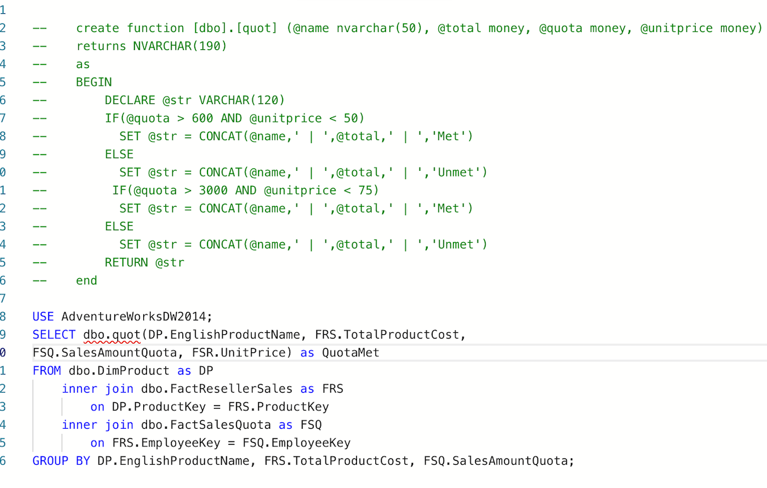
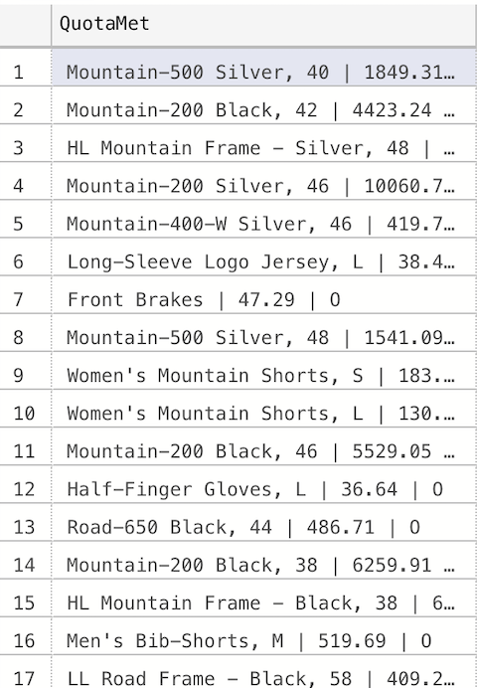
Individual Assessment - Fixed Worst 3 Problems
Query & Output:
Group Member: Serena Burton
Problem Type: Hard
Worst Problem #1
Problem #17: All products have a sales quota of $600 or more
List product names, their total product cost, and write 'O' if the quota was met or 'X' if the quota was not met
What did I change to fix this query?
Added different quotas for items of different prices.
Used “met” and “not met” to declare the status of the products
How did this improve my query?
My query now has more realistic quotas for each item
Quota status is communicated more effectively

Slide 18
Individual Assessment
Jerry Chacha

Slide 19
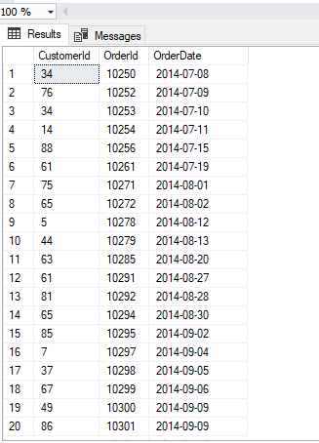
Individual Assessment - Top 3 Problems
Group Member: Jerry Chacha
Problem Type:Simple
Top Problem #1
Problem 4: How many orders used Shipper ETYNR
Why did I choose this problem for top rating?
It isolates all the orders based on one single shipping company.
It can help a person who wants to find orders shipped by this company.
Query: USE Northwinds2019TSQLV5
SELECT o.CustomerId
,o.OrderId
,o.OrderDate
FROM Sales.Shipper AS s
INNER JOIN Sales.[Order] AS o ON s.ShipperId = o.ShipperId
WHERE s.ShipperCompanyName = 'Shipper ETYNR'
ORDER BY o.CustomerId;;

Slide 20
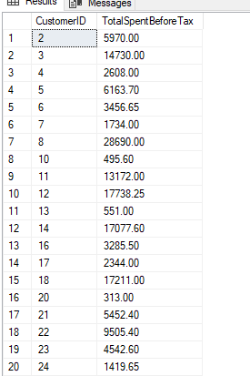
Individual Assessment - Top 3 Problems
Group Member: Jerry Chacha
Problem Type:Medium
Top Problem #2
Problem 11: What is the total amount spent,no sales Tax, by a customer on orders placed on January 2013?
Why did I choose this problem for top rating?
A company may want to see their total cost before sales tax was included on their orders
You can also change the WHERE clause to look for other months instead of January 2013
Query: USE WideWorldImporters
SELECT o.CustomerID
,SUM(ol.Quantity * ol.UnitPrice) AS TotalSpentBeforeTax
FROM Sales.Orders AS o
INNER JOIN Sales.OrderLines AS ol ON o.OrderID = ol.OrderID
WHERE o.OrderDate BETWEEN '20130101'
AND '20130131'
GROUP BY o.CustomerID
ORDER BY o.CustomerID;

Slide 21
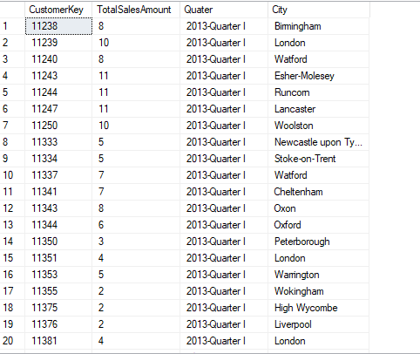
Individual Assessment - Top 3 Problems
Group Member: Jerry Chacha
Problem Type:Complex
Top Problem #3
Problem 12: Find the total orders placed by Customers in Great Britain in 2013 and group orders by the 2013 fiscal year
Why did I choose this problem for top rating?
It is easier to understand the output for individuals who want to read the total amount of orders placed by Quarters of a fiscal year rather than individual months
Query: USE AdventureWorksDW2016;
SELECT i.CustomerKey
,COUNT(i.SalesAmount) AS TotalSalesAmount
,dbo.findQuater(i.OrderDate) AS Quarter
,g.City
FROM dbo.FactInternetSales AS i
INNER JOIN dbo.DimCustomer AS c ON i.CustomerKey = c.CustomerKey
INNER JOIN dbo.DimGeography AS g ON g.GeographyKey = c.GeographyKey
WHERE (g.CountryRegionCode = 'GB')
AND i.OrderDate BETWEEN '20130101'
AND '20131231'
GROUP BY i.CustomerKey
,dbo.findQuater(i.OrderDate)
,g.City
ORDER BY i.CustomerKey;

Slide 22
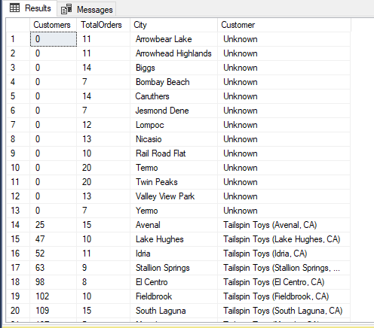
Individual Assessment - Worst 3 Problems
Group Member: Jerry Chacha
Problem Type: Medium
Worst Problem #1
Problem 10: Find the total orders for Californians customers for October 2014
Why did I choose this problem for worst rating?
There are customers with ID # 0 and there are unknowns in one column
There isn't much info on the Customer besides it ID number
USE WideWorldImportersDW
SELECT c.[Customer Key] AS Customers
,COUNT(o.[Order Key]) AS TotalOrders
,loc.City
,c.Customer
FROM Dimension.Customer AS c
INNER JOIN Fact."Order" AS o ON o.[Customer Key] = c.[Customer Key]
INNER JOIN Dimension.City AS loc ON o.[City Key] = loc.[City Key]
WHERE o.[Order Date Key] BETWEEN '20141001'
AND '20141031'
AND (loc.[State Province] = 'California')
GROUP BY c.[Customer Key]
,loc.City
,c.Customer
ORDER BY c.[Customer Key];

Slide 23
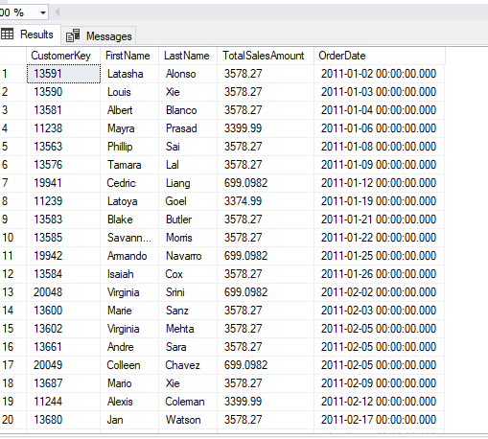
Individual Assessment - Worst 3 Problems
Group Member: Jerry Chacha
Problem Type: Medium
Worst Problem #2
Problem 7: How much did customers from Great Britain spend on orders during the months of January and February of 2011?
Why did I choose this problem for worst rating?
We don't know the amount of orders they placed. Maybe someone would like to their frequency of orders placed during this time frame
It is better to order by the amount of orders placed in descending order
USE AdventureWorksDW2016;
SELECT i.CustomerKey
,c.FirstName
,c.LastName
,SUM(i.SalesAmount) AS TotalSalesAmount
,i.OrderDate
FROM dbo.FactInternetSales AS i
INNER JOIN dbo.DimCustomer AS c ON i.CustomerKey = c.CustomerKey
INNER JOIN dbo.DimGeography AS g ON g.GeographyKey = c.GeographyKey
WHERE (g.CountryRegionCode = 'GB')
AND i.OrderDate BETWEEN '20110101'
AND '20110228'
GROUP BY i.CustomerKey
,i.OrderDate
,c.FirstName
,c.LastName
ORDER BY i.OrderDate;

Slide 24
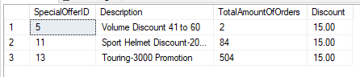
Individual Assessment - Worst 3 Problems
Group Member: Jerry Chacha
Problem Type: Medium
Worst Problem #3
Problem 20: How many orders offered a 15% Discount and what was the name of the discount given?
Why did I choose this problem for worst rating?
We don’t know the names of the Customers who’ve ordered these discounted products
The output does not provide how much they spent on products with a given 15% discount.
USE AdventureWorks2014
SELECT so.SpecialOfferID
,so.[Description]
,COUNT(od.SalesOrderDetailID) AS TotalAmountOfOrders
,so.DiscountPct * 100 AS Discount
FROM Sales.SalesOrderDetail AS od
INNER JOIN Sales.SpecialOffer AS so ON so.SpecialOfferID = od.SpecialOfferID
WHERE od.UnitPriceDiscount = 0.15
GROUP BY so.SpecialOfferID
,so.[Description]
,so.DiscountPct
ORDER BY so.SpecialOfferID

Slide 25
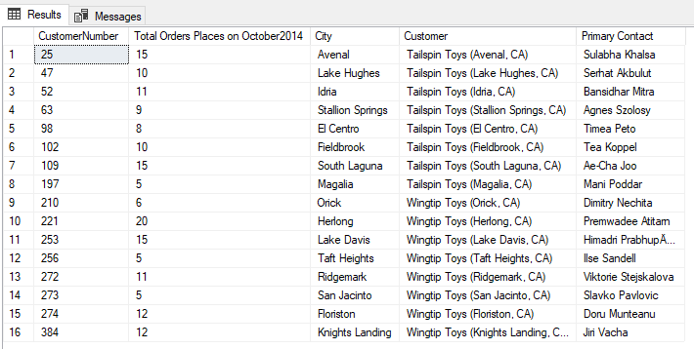
Individual Assessment - Fixed Worst 3 Problems
Group Member: Jerry Chacha
Problem Type:Medium
Worst Problem #1
Problem 10: Find the total orders for Californians customers for October 2014
What did I change to fix this query?
I removed any customers with no id number and included the Name of the Customer and their contact information
How did this improve my query?
Removed invalid customers, and added more information about the customer.
Query: USE WideWorldImportersDW
SELECT c.[Customer Key] AS CustomerNumber
,COUNT(o.[Order Key]) AS [Total Orders Places on October2014]
,loc.City
,c.Customer
,c.[Primary Contact]
FROM Dimension.Customer AS c
INNER JOIN Fact."Order" AS o ON o.[Customer Key] = c.[Customer Key]
INNER JOIN Dimension.City AS loc ON o.[City Key] = loc.[City Key]
WHERE o.[Order Date Key] BETWEEN '20141001'
AND '20141031'
AND (loc.[State Province] = 'California')
AND c.[Customer Key] != 0
GROUP BY c.[Customer Key]
,loc.City
,c.Customer
,c.[Primary Contact]
ORDER BY c.[Customer Key];

Slide 26
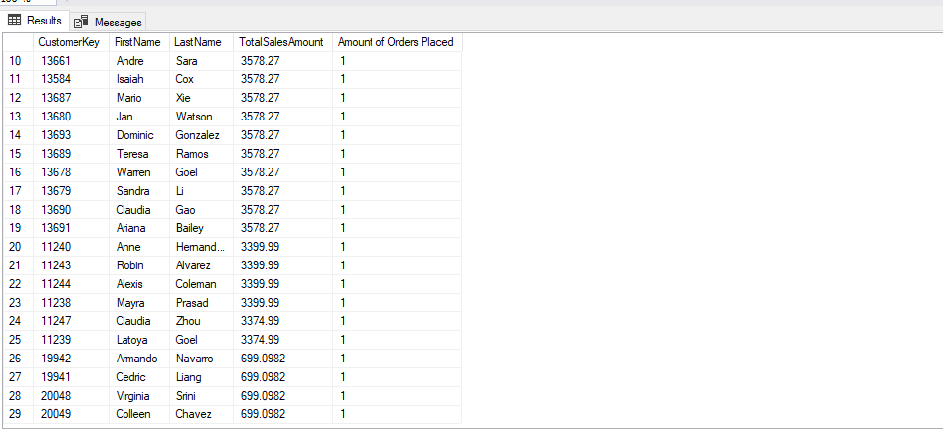
Individual Assessment - Fixed Worst 3 Problems
Group Member: Jerry Chacha
Problem Type:Medium
Worst Problem #2
Problem 7: How much did customers from Great Britain spend on orders during the months of January and February of 2011?
What did I change to fix this query?
I added a column to count the number of orders placed in the two months and ordered by the amount each customer spent in descending order
How did this improve my query?
The output gives a better information on how much was spent on how many orders
Query:USE AdventureWorksDW2016;
SELECT i.CustomerKey
,c.FirstName AS [Customer First Name]
,c.LastName AS [Customer Last Name]
,SUM(i.SalesAmount) AS TotalSalesAmount
,COUNT(i.SalesOrderNumber) AS [Amount of Orders Placed]
FROM dbo.FactInternetSales AS i
INNER JOIN dbo.DimCustomer AS c ON i.CustomerKey = c.CustomerKey
INNER JOIN dbo.DimGeography AS g ON g.GeographyKey = c.GeographyKey
WHERE (g.CountryRegionCode = 'GB')
AND i.OrderDate BETWEEN '20110101'
AND '20110228'
GROUP BY i.CustomerKey
,i.OrderDate
,c.FirstName
,c.LastName
ORDER BY SUM(i.SalesAmount) DESC

Slide 27
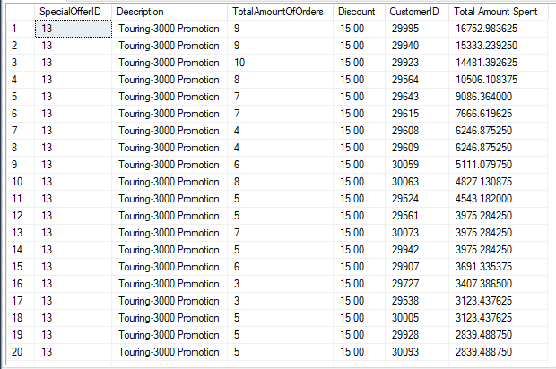
Individual Assessment - Fixed Worst 3 Problems
Group Member: Jerry Chacha
Problem Type:Medium
Worst Problem #3
Problem 10: How many orders offered a 15% Discount and what was the name of the discount given?
What did I change to fix this query?
I added a column to count amount spent from Customers using this 15% discount for June 2013
How did this improve my query?
The output gives a better understanding on which customers used a 15% and their total spending
Query:USE AdventureWorks2014
SELECT so.SpecialOfferID
,so.[Description]
,COUNT(od.SalesOrderDetailID) AS TotalAmountOfOrders
,so.DiscountPct * 100 AS Discount
,oh.CustomerID
,SUM(od.LineTotal) AS [Total Amount Spent]
FROM Sales.SalesOrderDetail AS od
INNER JOIN Sales.SpecialOffer AS so ON so.SpecialOfferID = od.SpecialOfferID
INNER JOIN Sales.SalesOrderHeader AS oh ON od.SalesOrderID = oh.SalesOrderID
WHERE od.UnitPriceDiscount = 0.15
AND oh.OrderDate BETWEEN '20130601'
AND '20130630'
GROUP BY so.SpecialOfferID
,so.[Description]
,so.DiscountPct
,oh.CustomerID
ORDER BY SUM(od.LineTotal) DESC

Slide 28
Individual Assessment
Thomas Jimenez

Slide 29
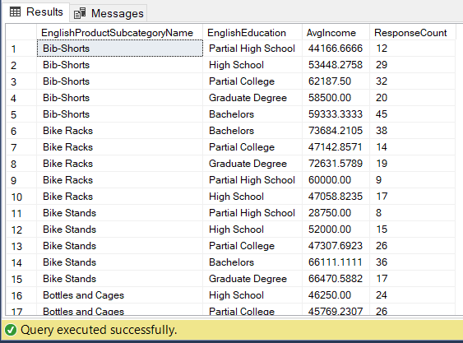
Individual Assessment - Top 3 Problems
Group Member: Thomas Jimenez
Problem Type: Medium
Top Problem #1
Problem 11: Who fills out the feedback surveys? How do we increase feedback survey
responses?
Why did I choose this problem for top rating?
Gives specific information about which products tend to make customers give the most feedback
Feedback data is free and valuable for the company to improve their products
Query:
USE [AdventureWorksDW2016];
SELECT S.EnglishProductSubcategoryName
,C.EnglishEducation
,AVG(C.YearlyIncome) AS AvgIncome
,COUNT(DISTINCT S.CustomerKey) AS ResponseCount
FROM dbo.FactSurveyResponse AS S
INNER JOIN dbo.DimCustomer AS C ON C.CustomerKey = S.CustomerKey
GROUP BY S.EnglishProductSubcategoryName
,C.EnglishEducation
ORDER BY EnglishProductSubcategoryName
Sample Output:

Slide 30
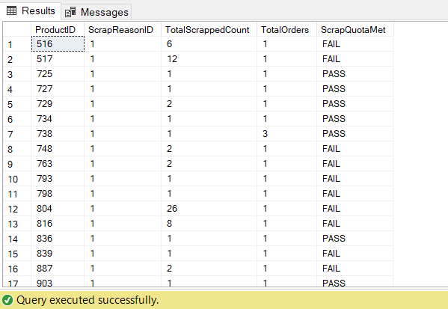
Individual Assessment - Top 3 Problems
Group Member: Thomas Jimenez
Problem Type: Complex
Top Problem #2
Problem 15: Which products have a high production fail rate?
Why did I choose this problem for top rating?
It is important to minimize costs for your business when possible
Improving production rate processes can help speed up production and increase profit
Sample Output:
Query:
--Custom Scalar
CREATE FUNCTION SCRAPQUOTA(
@quantity smallint,
@amount money
)
RETURNS NVARCHAR(4)
AS
BEGIN
RETURN(
CASE
WHEN @quantity*@amount < 1000 THEN 'PASS'
ELSE 'FAIL'
END
)
END
--Query
USE AdventureWorks2014;
SELECT WO.ProductID
,SR.ScrapReasonID
,WO.ScrappedQty AS TotalScrappedCount
,COUNT(DISTINCT WO.WorkOrderID) AS TotalOrders
,dbo.SCRAPQUOTA(Wo.ScrappedQty, P.ListPrice) AS ScrapQuotaMet
FROM Production.WorkOrder AS WO
INNER JOIN Production.Product AS P ON WO.ProductID = P.ProductID
INNER JOIN Production.ScrapReason AS SR ON WO.ScrapReasonID = SR.ScrapReasonID
GROUP BY WO.ProductID
,WO.ScrappedQty
,SR.ScrapReasonID
,P.ListPrice
HAVING SUM(WO.ScrappedQty) > 0
AND P.ListPrice > 0
ORDER BY ScrapReasonID

Slide 31
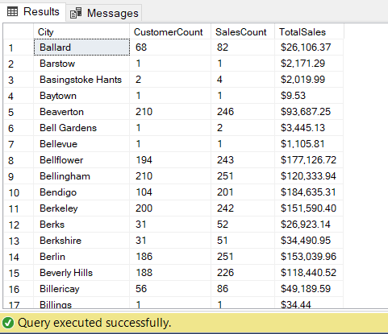
Individual Assessment - Top 3 Problems
Group Member: Thomas Jimenez
Problem Type: Medium
Top Problem #3
Problem 09: What are the customer and sales numbers for every city?
Why did I choose this problem for top rating?
This will give you a big picture about where the company's primary customer base resides
It can give you information about where the biggest customers reside (few orders and large sales revenue)
Can give insight of where to delegate marketing resources
Query:
USE [AdventureWorksDW2016];
SELECT G.City
,COUNT(DISTINCT C.CustomerKey) AS CustomerCount
,COUNT(DISTINCT S.SalesOrderNumber) AS SalesCount
,FORMAT(SUM(S.TotalProductCost), 'C') AS TotalSales
FROM dbo.FactInternetSales AS S
INNER JOIN dbo.DimCustomer AS C ON S.CustomerKey = C.CustomerKey
INNER JOIN dbo.DimGeography AS G ON C.GeographyKey = G.GeographyKey
GROUP BY G.City;
Sample Output:

Slide 32
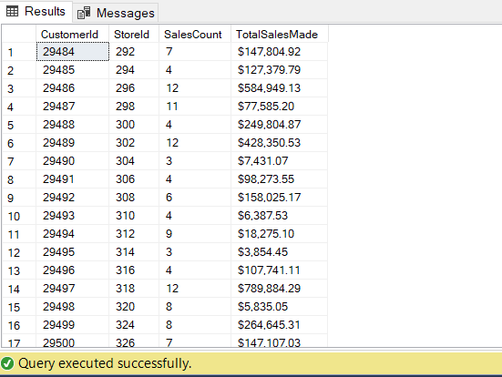
Individual Assessment - Worst 3 Problems
Group Member: Thomas Jimenez
Problem Type: Medium
Worst Problem #1
Problem 12: What are the total sales numbers at each physical store? How many purchases did each customer make?
Why did I choose this problem for worst rating?
Comparing sales numbers should be done over multiple years, it is useless without historical data
Query:
USE [AdventureWorks2014];
SELECT OH.CustomerId
,C.StoreId
,COUNT(DISTINCT OH.SalesOrderID) AS SalesCount
,FORMAT(SUM(OH.TotalDue), 'C') AS TotalSalesMade
FROM Sales.SalesOrderHeader AS OH
INNER JOIN Sales.Customer AS C ON OH.CustomerId = C.CustomerID
WHERE C.StoreID IS NOT NULL
GROUP BY OH.CustomerID
,C.StoreId
ORDER BY C.StoreID;
Sample Output:

Slide 33
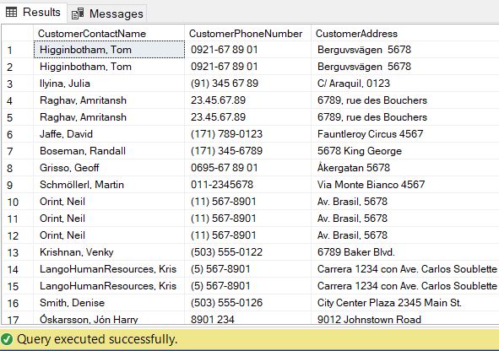
Individual Assessment - Worst 3 Problems
Group Member: Thomas Jimenez
Problem Type: Simple
Worst Problem #2
Problem 05: Which customers have received orders that were shipped late?
Why did I choose this problem for worst rating?
There are some duplicate entries. As long as we see each unique customer once it should be enough to give them discounts for their inconvenience
Query:
USE Northwinds2019TSQLV5;
SELECT C.CustomerContactName
,C.CustomerPhoneNumber
,C.CustomerAddress
,C.CustomerAddress
,C.CustomerPostalCode
,C.CustomerCountry
,O.ShipperId
,O.OrderDate
,O.RequiredDate
,O.ShipToDate
FROM Sales.[Order] AS O
INNER JOIN Sales.Customer AS C ON O.CustomerId = C.CustomerId
WHERE ShipToDate > RequiredDate;
Sample Output:

Slide 34
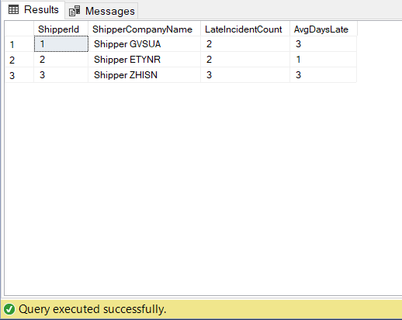
Individual Assessment - Worst 3 Problems
Group Member: Thomas Jimenez
Problem Type: Medium
Worst Problem #3
Problem 08: What is the late shipment incident data for the different shipping companies?
Why did I choose this problem for worst rating?
AverageDaysLate doesn’t give clearly useful information
It would be more useful to know more details about which customers were involved and individual incident details
Query:
USE [Northwinds2019TSQLV5];
SELECT O.ShipperId
,S.ShipperCompanyName
,COUNT(O.OrderId) AS LateIncidentCount
,AVG(DATEDIFF(day, O.RequiredDate, O.ShipToDate)) AS AvgDaysLate
FROM Sales.[Order] AS O
INNER JOIN Sales.Shipper AS S ON O.ShipperId = S.ShipperId
WHERE ShipToDate > RequiredDate
AND YEAR(O.OrderDate) = '2014'
GROUP BY O.ShipperId
,S.ShipperCompanyName;
Sample Output:

Slide 35
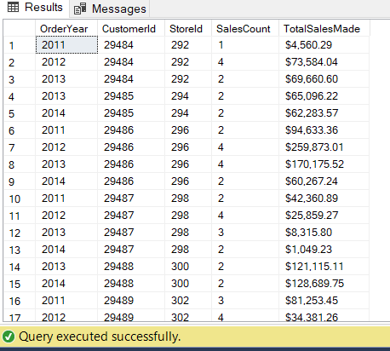
Individual Assessment - Fixed Worst 3 Problems
Group Member: Thomas Jimenez
Problem Type: Medium
Worst Problem #1
Problem 12: What are the total sales numbers at each physical store? How many purchases did each customer make?
What did I change to fix this query?
Added a column to track OrderDate Year and made the query group by it
How did this improve my query?
Gives more historical data on each customer. Can be ungrouped to give general data about sales numbers at each store
Query:
USE [AdventureWorks2014];
SELECT YEAR(OH.OrderDate) AS OrderYear
,OH.CustomerId
,C.StoreId
,COUNT(DISTINCT OH.SalesOrderID) AS SalesCount
,FORMAT(SUM(OH.TotalDue), 'C') AS TotalSalesMade
FROM Sales.SalesOrderHeader AS OH
INNER JOIN Sales.Customer AS C ON OH.CustomerId = C.CustomerID
WHERE C.StoreID IS NOT NULL
GROUP BY YEAR(OH.OrderDate)
,OH.CustomerID
,C.StoreId
ORDER BY C.StoreID;
Sample Output:

Slide 36
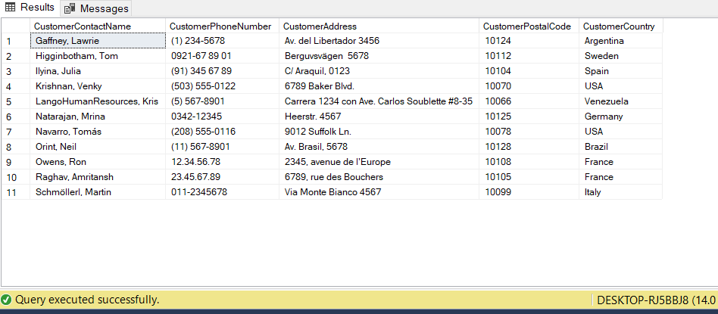
Individual Assessment - Fixed Worst 3 Problems
Group Member: Thomas Jimenez
Problem Type: Simple
Worst Problem #2
Problem 05: Which customers have received orders that were shipped late?
What did I change to fix this query?
Added distinct clause to not repeat customers
Removed double “C.CustomerAddress”
Added clause to make customers who got late orders in 2016 visible
How did this improve my query?
It gives one column for each distinct customer who recieved a late order during a specific range of time. Old incidents may not be relevant anymore. Let’s you focus on customers who have been failed recently
Query:
USE Northwinds2019TSQLV5;
SELECT DISTINCT C.CustomerContactName
,C.CustomerPhoneNumber
,C.CustomerAddress
,C.CustomerPostalCode
,C.CustomerCountry
FROM Sales.[Order] AS O
INNER JOIN Sales.Customer AS C ON O.CustomerId = C.CustomerId
WHERE O.ShipToDate > O.RequiredDate
AND YEAR(O.ShipToDate) = 2016;
Sample Output:

Slide 37
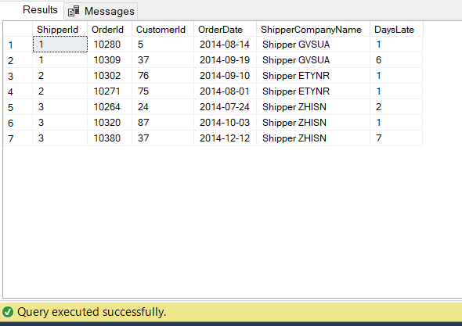
Individual Assessment - Fixed Worst 3 Problems
Group Member: Thomas Jimenez
Problem Type: Medium → Simple
Worst Problem #3
Problem 08: What is the late shipment incident data for the different shipping companies?
What did I change to fix this query?
Removed GROUP BY
Added ORDER BY
Showed DaysLate for each incident
How did this improve my query?
Give more specific details about late incidents for each shipper and which customers were involved.
Query gives more information when not grouped as the amount of orders is small and each incident can be addressed
Query:
USE [Northwinds2019TSQLV5];
SELECT O.ShipperId
,O.OrderId
,O.CustomerId
,O.OrderDate
,S.ShipperCompanyName
,DATEDIFF(day, O.RequiredDate, O.ShipToDate) AS DaysLate
FROM Sales.[Order] AS O
INNER JOIN Sales.Shipper AS S ON O.ShipperId = S.ShipperId
WHERE ShipToDate > RequiredDate
AND YEAR(O.OrderDate) = '2014'
ORDER BY ShipperId;
Sample Output:

Slide 38
Individual Assessment
Jianguo Jin

Slide 39
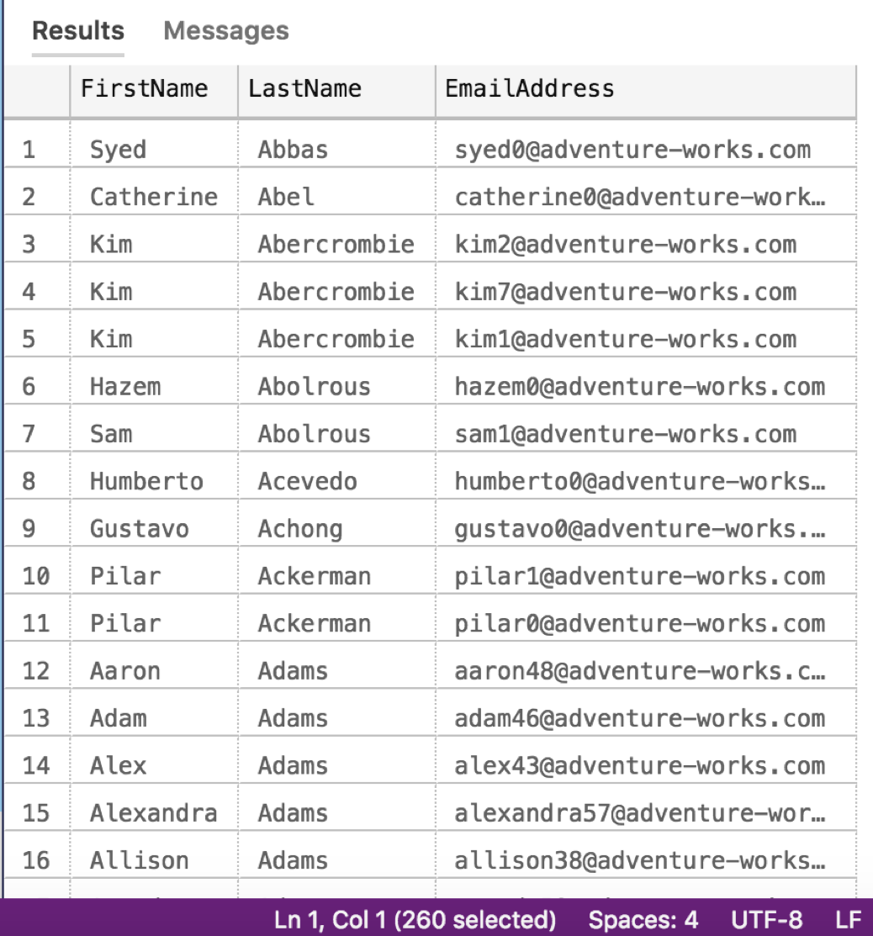
Individual Assessment - Top 3 Problems
Sample Output:
Group Member: Jianguo Jin
Problem Type: Simple
Problem 4: Find Employee’s firstname,lastname and email address.
Why did I choose this problem for top rating?
Easy to find email address
Ordered by Name
Query:
select P.FirstName , P.LastName , E.EmailAddress
From Person.EmailAddress as E
inner join Person.Person as P
on E.BusinessEntityID = P.BusinessEntityID
Order by P.LastName,P.FirstName

Slide 40
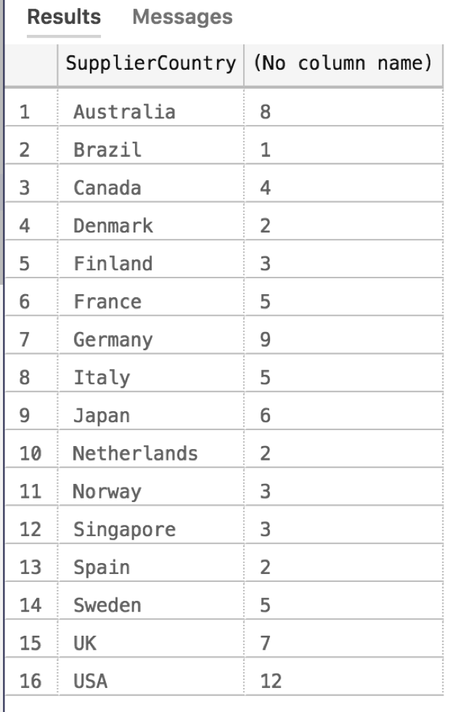
Individual Assessment - Top 3 Problems
Group Member: Jianguo Jin
Problem Type: Medium
Problem 7:How many kinds of products are supplied from each country?
Why did I choose this problem for top rating?
Shows distribution of suppliercountry and amount of product from every country
Query:
SELECT S.SupplierCountry, count (P.ProductName)
from Production.Product as P
inner join Production.Supplier as S
on P.SupplierId= S.SupplierId
group by S.SupplierCountry
Sample Output:

Slide 41
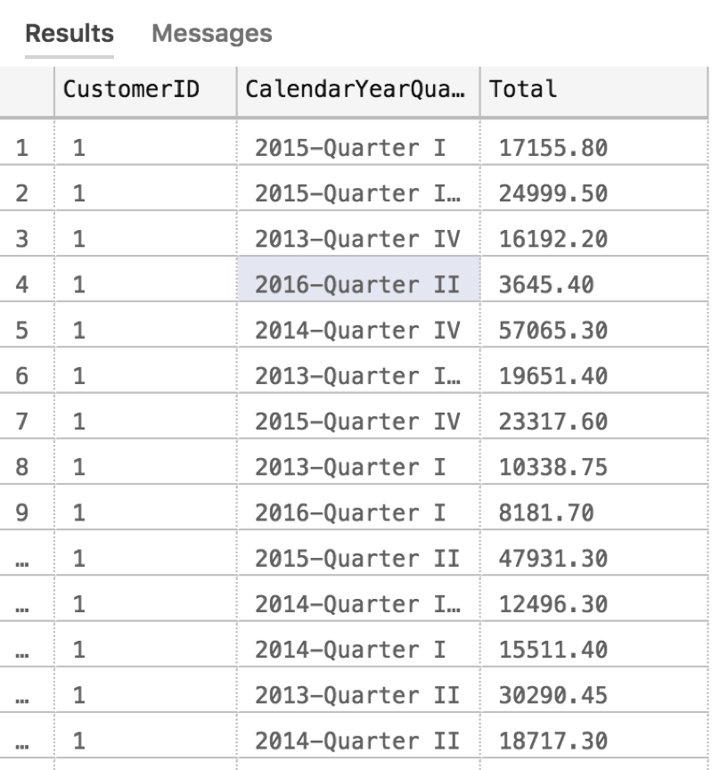
Individual Assessment - Top 3 Problems
Group Member: Jianguo Jin
Problem Type: Complex
Problem 17: Find CustomerID and compute total the customer spend every Quarter Year
Why did I choose this problem for top rating?
The custom scalar function helps to sort data
Output:
Query:
CREATE FUNCTION dbo.FindCalendarYearQuarter (@mydate date)
RETURNS NVARCHAR(20)
AS
BEGIN
DECLARE @yyear date;
declare @r NVARCHAR(15);
select @r =case when month(@mydate) <=3 then '-Quarter I'
when month(@mydate) <=6 then '-Quarter II'
when month(@mydate) <=9 then '-Quarter III'
else '-Quarter IV'
END
RETURN concat(year(@mydate), @r)
END;
select I.CustomerID,dbo.FindCalendarYearQuarter(O.OrderDate) as CalendarYearQuarter , sum(OL.UnitPrice*OL.Quantity) as Total
from Sales.Orders as O
inner join Sales.OrderLines as OL
on O.OrderID= OL.OrderID
inner join Sales.Invoices as I
on O.OrderID=I.OrderID
group by dbo.FindCalendarYearQuarter(O.OrderDate),I.CustomerID
order by I.CustomerID

Slide 42
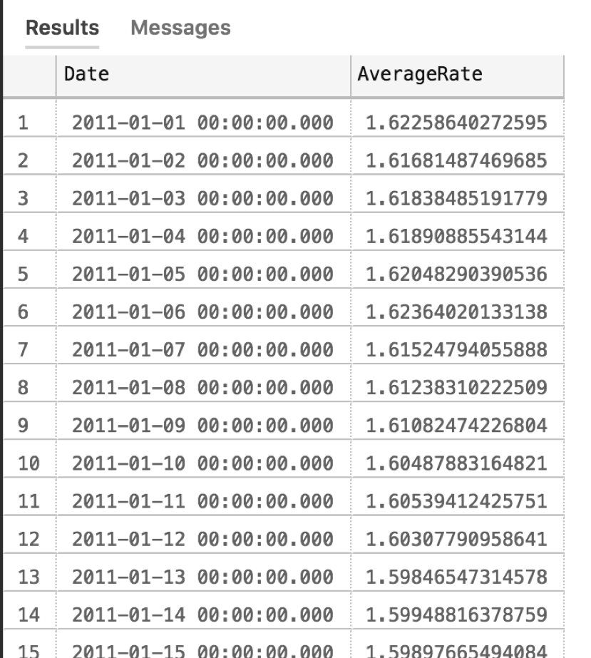
Individual Assessment - Worst 3 Problems
Query:
select FCR.[Date], FCR.AverageRate
from dbo.DimCurrency as C
inner join dbo.FactCurrencyRate as FCR
on C.CurrencyKey= FCR.CurrencyKey
where C.CurrencyName ='United Kingdom Pound' and year(FCR.[Date])=2011
Sample Output:
Group Member: Jianguo Jin
Problem Type: Simple
Problem 5: Show the everyday AverageRate of pound in 2011.
Why did I choose this problem for worst rating?
In the column of the date, the time is useless and it is removable.

Slide 43
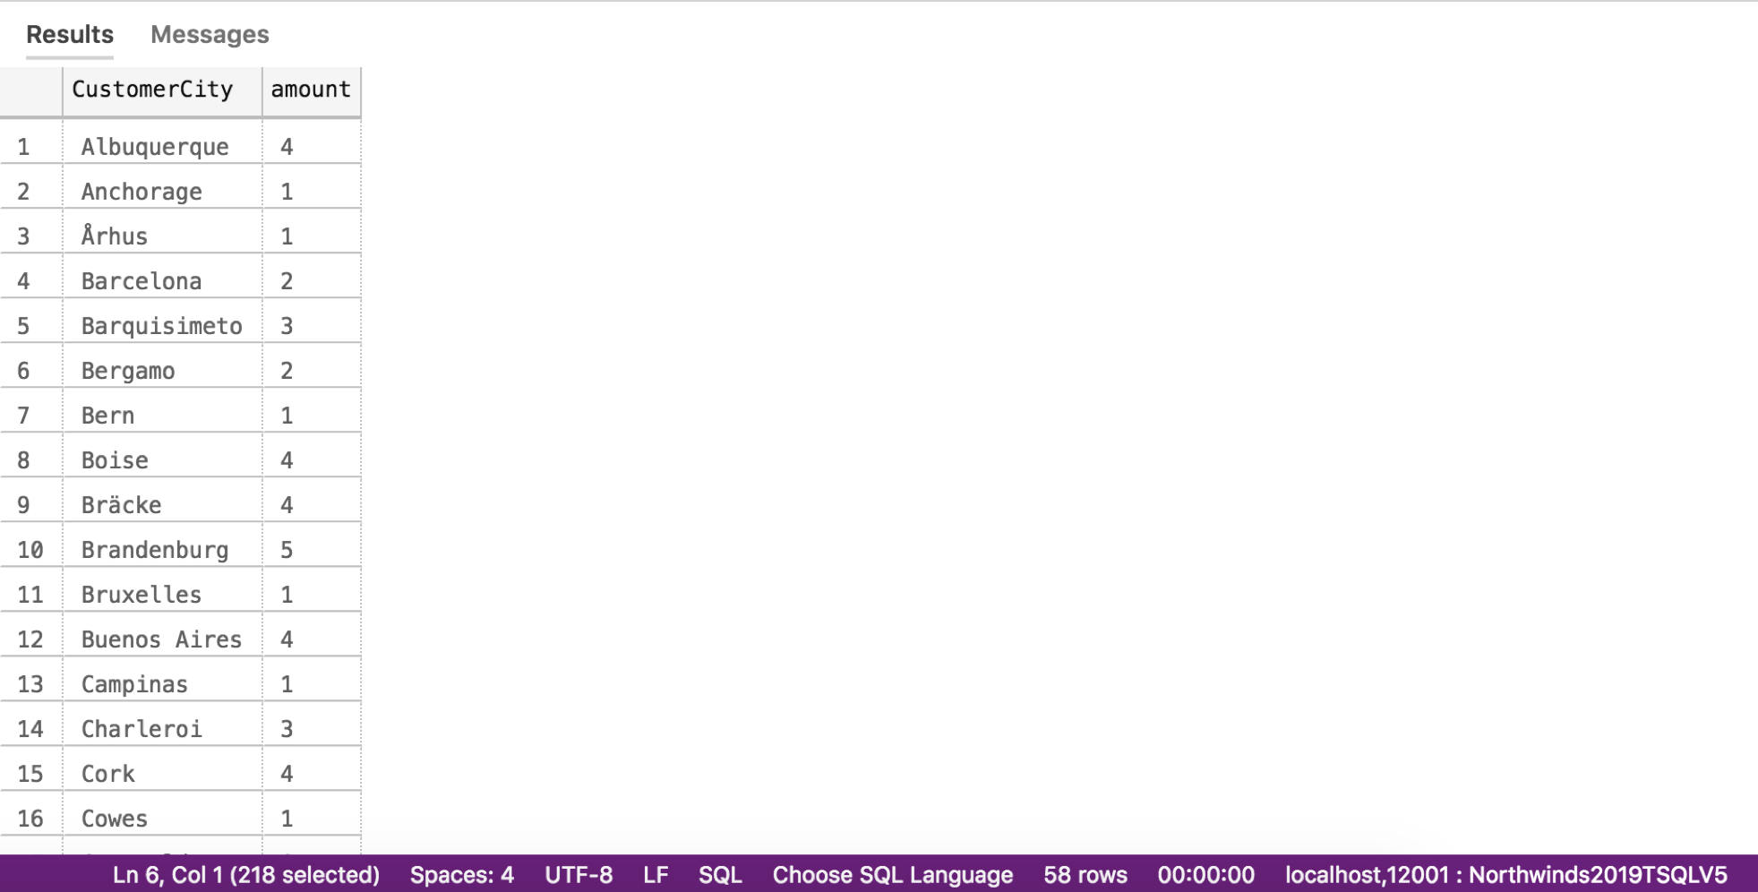
Individual Assessment - Worst 3 Problems
Query:
select C.CustomerCity, count(O.OrderId) as amount
from Sales.Customer as C
inner join Sales.[Order] as O
on C.CustomerId= O.CustomerId
where O.OrderDate BETWEEN '20150101' and '20150630'
group by C.CustomerCity
Sample Output:
Group Member: Jianguo Jin
Problem Type: Medium
Problem 6: Find the amount of orders from every city that OrderDate is between 20150101 and 20150630
Why did I choose this problem for worst rating?
From the result, only can find the cities and the order number. It is incomplete data. It is better to add country name to know the city is which country

Slide 44
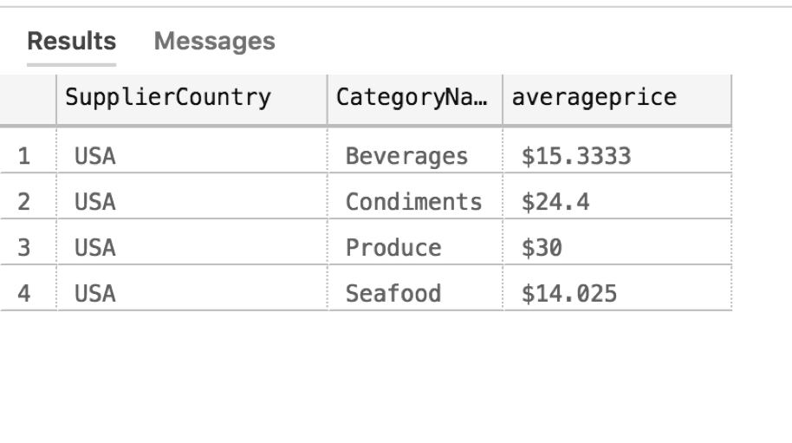
Individual Assessment - Worst 3 Problems
Group Member: Jianguo Jin
Problem Type: Complex
Problem 15: Find each categoryName and it's average price from SupplierCountry is USA
Why did I choose this problem for worst rating?
scalar function does useless work
Output:
Query:
Create function dbo.price(@uniteprice float)
returns nvarchar(10)
BEGIN
return concat('$',@uniteprice)
end
use Northwinds2019TSQLV5
;
SELECT S.SupplierCountry, C.CategoryName, dbo.price(avg(P.UnitPrice)) as averageprice
from Production.Product as P
inner join Production.Category as C
on P.CategoryId=C.CategoryId
inner join Production.Supplier as S
on P.SupplierId= S.SupplierId
where S.SupplierCountry='USA'
group by S.SupplierCountry,C.CategoryName

Slide 45
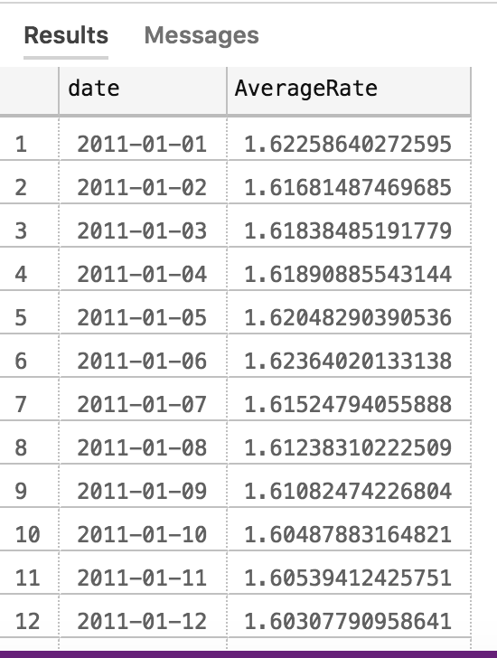
Individual Assessment - Fixed Worst 3 Problems
Group Member: Jianguo Jin
Problem Type: Simple
Problem 5: Proposition Goes Here
What did I change to fix this query?
select FCR.[Date], FCR.AverageRate
→
select convert(date,FCR.[Date]) as date ,FCR.AverageRate
How did this improve my query?
Converted the data type of the date
datetime → date
Query:
select convert(date,FCR.[Date]) as date, FCR.AverageRate
from dbo.DimCurrency as C
inner join dbo.FactCurrencyRate as FCR
on C.CurrencyKey= FCR.CurrencyKey
where C.CurrencyName LIKE N'%Pound' and year(FCR.[Date])=2011
Sample Output:

Slide 46
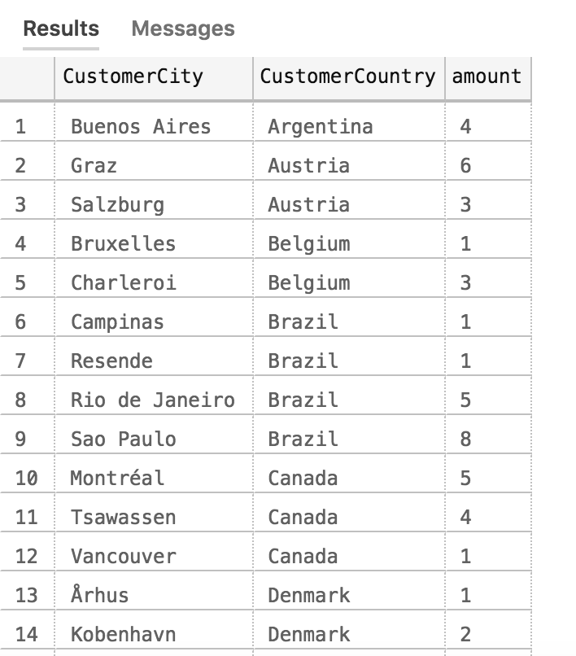
Individual Assessment - Fixed Worst 3 Problems
Query:
select C.CustomerCity,C.CustomerCountry, count(O.OrderId) as amount
from Sales.Customer as C
inner join Sales.[Order] as O
on C.CustomerId= O.CustomerId
where O.OrderDate BETWEEN '20150101' and '20150630'
group by C.CustomerCity,C.CustomerCountry
Sample Output:
Group Member: Jianguo Jin
Problem Type: Medium
Problem 6: Find the amount of orders from every city that OrderDate is between 20150101 and 20150630
What did I change to fix this query?
added C.CustomerCountry in select clause
added C.CustomerCountry in group by
How did this improve my query?
Since added the country name, we can easily find the city is which country.

Slide 47
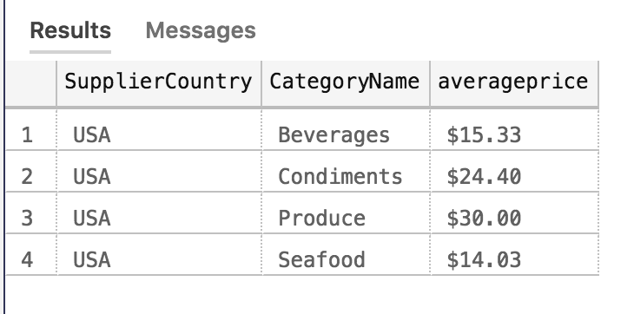
Individual Assessment - Fixed Worst 3 Problems
Query:
SELECT S.SupplierCountry, C.CategoryName, concat('$',avg(P.UnitPrice)) as averageprice
from Production.Product as P
inner join Production.Category as C
on P.CategoryId=C.CategoryId
inner join Production.Supplier as S
on P.SupplierId= S.SupplierId
where S.SupplierCountry='USA'
group by S.SupplierCountry,C.CategoryName
Sample Output:
Group Member: Jianguo Jin
Problem Type: Complex
Problem 15: Find number of employee's jobtitle from each department whose wage is over 30
What did I change to fix this query?
Remove the custom function and simplify the query
Used Concat()
How did this improve my query?
Does the same work.
Code is simpler

Slide 48
Individual Assessment
Steven Marmolejo

Slide 49
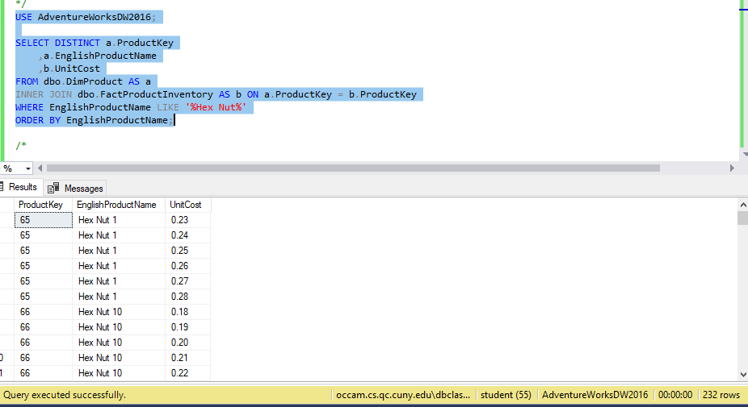
Individual Assessment - Top 3 Problems
Group Member: Steven Marmolejo
Problem Type:Simple
Top Problem #1
Problem 3: Find The unit cost of all Hex Nuts
Why did I choose this problem for top rating?
This query is simple to the point, and gives the name of the product as well as the unit cost.
Query:

Slide 50
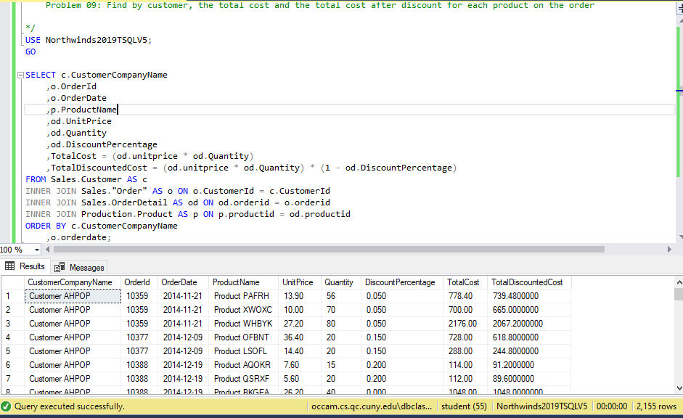
Individual Assessment - Top 3 Problems
Group Member: Steven Marmolejo
Problem Type:Medium
Top Problem #2
Problem 9: Find by customer, the total cost and the total cost after discount for each product on the order
Why did I choose this problem for top rating?
This problem was chosen because it allows the user to see all the discounted values without having to calculate it individually for each product
Query:

Slide 51
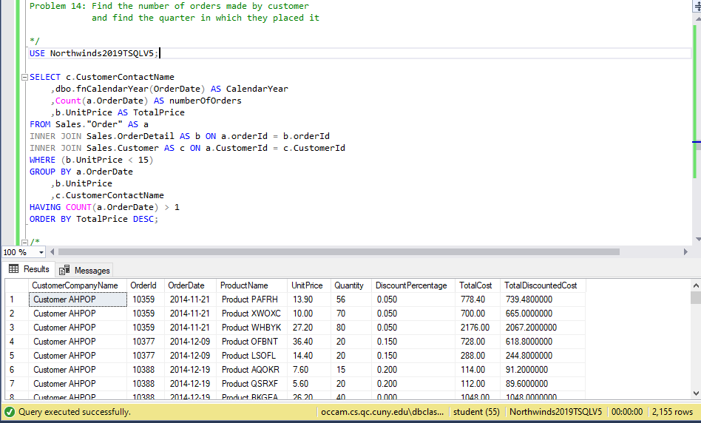
Individual Assessment - Top 3 Problems
Group Member: Steven Marmolejo
Problem Type:Complex
Top Problem #3
Problem 14: Find the number of orders made by customer and find the quarter in which they placed it
Why did I choose this problem for top rating?
This allows the user to classify orders for the fiscal quarter the order was made in
With the use of a function it is easy to calculate the year in quarters
Query:

Slide 52
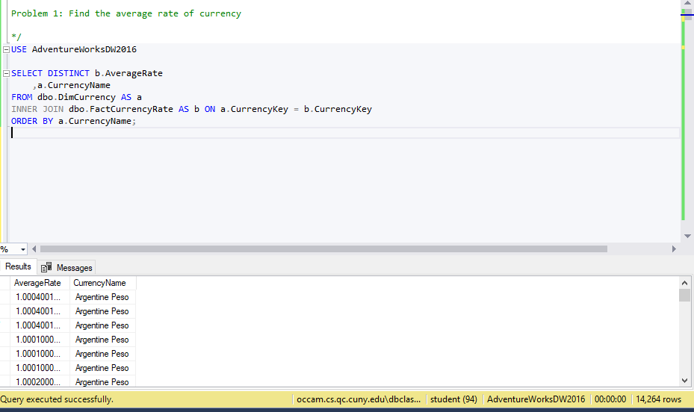
Individual Assessment - Worst 3 Problems
Group Member: Steven Marmolejo
Problem Type: Simple
Worst Problem #1
Problem 1: Find the average rate of currency
Why did I choose this problem for worst rating?
I should’ve added the date at which the currency rate was at
Query:

Slide 53

Individual Assessment - Worst 3 Problems
Group Member: Steven Marmolejo
Problem Type: Medium
Worst Problem #2
Problem 12: Find the unitprice and discount amount and name of discount
Why did I choose this problem for worst rating?
I could’ve added another condition to remove the null values from the MaxQuantity column so it wouldn’t appear in the results
Query:

Slide 54

Individual Assessment - Worst 3 Problems
Group Member: Steven Marmolejo
Problem Type: Complex
Worst Problem #3
Problem 17: Find the category and name of product, its price, and name of supplier
Why did I choose this problem for worst rating?
I need to take into account which currency the user is dealing with because it is formatted to US currency right now
Query:

Slide 55

Individual Assessment - Fixed Worst 3 Problems
Group Member: Steven Marmolejo
Problem Type:Simple
Worst Problem #1
Problem 3: Find the average rate of currency
What did I change to fix this query?
I added an orderdate column
How did this improve my query?
It adds the date of thecurrency rate which allows the user to more accuratly determine the currency rate

Slide 56

Individual Assessment - Fixed Worst 3 Problems
Group Member: Steven Marmolejo
Problem Type:Medium
Worst Problem #2
Problem 12: Find the unitprice and discount amount and name of discount
What did I change to fix this query?
I added a condition to not include nulls in the MaxQty column
How did this improve my query?
This allowed the list of results to be smaller
It only includes discounts with quantity requirement

Slide 57

Individual Assessment - Fixed Worst 3 Problems
Group Member: Steven Marmolejo
Problem Type:Complex
Worst Problem #3
Problem 17: Find the category and name of product, its price, and name of supplier
What did I change to fix this query?
Added a comment to inform how to change for different currencies
How did this improve my query?
Allows the code to be clear for any user that wants to implement

Slide 58
Individual Assessment
Mudit Prashar

Slide 59


Individual Assessment - Top 3 Problems
Group Member: Mudit Prashar
Problem Type: Simple
Top Problem #1
Problem 3: Find the description of items whose last cost price is less than $5 using WideWorldImporters?
Why did I choose this problem for top rating?
It combines the stock item holding table and outputs all the item’s description which is under $5.
It can help if a person wants to look at the items and know what it really is and it also shows the cost price for that item.
Query:
Sample Output:

Slide 60


Individual Assessment - Top 3 Problems
Group Member: Mudit Prashar
Problem Type: Medium
Top Problem #2
Problem 8: Find the total number of orders placed of each stock item using WideWorldImportersDW?
Why did I choose this problem for top rating?
This problem counts the total number of orders placed for each item in the stock in the year 2016.
a company can use it to check the inventory of the products or even use it to get an idea of all the orders they got in 2016.
Query:
Sample Output:

Slide 61



Individual Assessment - Top 3 Problems
Group Member: Mudit Prashar
Problem Type: Complex
Top Problem #3
Problem 15: Find the name of the Customers, number of clothing internet sales order they placed and also count the number of years since they made their first purchase up until today using AdventureWorksDW 2016?
Why did I choose this problem for top rating?
This Query uses two built in functions and shows the full name and the show the number of years they have been a customer which is measure by subtracting the order date of the first order they ever made to the present date.
Query:
Sample Output:

Slide 62


Individual Assessment - Worst 3 Problems
Group Member: Mudit Prashar
Problem Type: Simple
Worst Problem #1
Problem 2: Find the product names that had internet sale and had order date year 2010 using AdventureWorksDW 2016?
Why did I choose this problem for worst rating?
This Query is bad because it constraints the output to only one year and the Order date can be formatted in better and more interactive way.
Suppose if a person wants to see product names in french then that would cause a problem also since it only shows product names in english.
Query:
Sample Output:

Slide 63


Individual Assessment - Worst 3 Problems
Group Member: Mudit Prashar
Problem Type: Medium
Worst Problem #2
Problem 13: Find the Total number of orders placed during internet sales that used different currencies and don't show the currencies that were never used using AdventureWorksDW 2016?
Why did I choose this problem for worst rating?
This Query doesn’t show the unused currencies which can be helpful if the person is analysis this data for some survey to see that no one uses this currency.
Secondly it will be more interactive or useful the order is for the last column instead of Currency Name.
Query:
Sample Output:

Slide 64



Individual Assessment - Worst 3 Problems
Group Member: Mudit Prashar
Problem Type:Complex
Worst Problem #3
Problem 19: Find the all the orders that were placed in 2013 and show the order date in form of fiscal year quarters with january as the 1st month for first quarter and also calculate the total amount paid for each order ID including taxes using WideWorldImporters?
Why did I choose this problem for worst rating?
This Query creates a problem by constraining the query to output orders of one year which is 2013 in this case
Query:
Sample Output:

Slide 65


Individual Assessment - Fixed Worst 3 Problems
Group Member: Mudit Prashar
Problem Type: Simple
Worst Problem #1
Problem 2: Find the product names that had internet sale using AdventureWorksDW 2016?
What did I change to fix this query?
I deleted the where clause and use the convert built in function to format the date in common format known. Also added two new columns.
How did this improve my query?
Adding columns shows the product name in 3 different languages now and removing the where clause doesn’t constrain the output to one year.
Query:
Sample Output:

Slide 66


Individual Assessment - Fixed Worst 3 Problems
Group Member: Mudit Prashar
Problem Type: Medium
Worst Problem #2
Problem 13: Find the Total number of orders placed during internet sales that used different currencies using AdventureWorksDW 2016?
What did I change to fix this query?
I changed the Join Clause to Full Outer Join instead of Inner Join.
How did this improve my query?
It shows the other currencies as well even no one ever used to make a purchase.
Query:
Sample Output:

Slide 67


Individual Assessment - Fixed Worst 3 Problems
Group Member: Mudit Prashar
Problem Type: Complex
Worst Problem #3
Problem 19: Find the all the orders that were placed and show the order date in
form of fiscal year quarters with january as the 1st month for first quarter and also calculate the total amount paid for each order ID including taxes using WideWorldImporters?
What did I change to fix this query?
Removed the where clause from the query.
How did this improve my query?
Output is changed before it was showing orders just for 2013 but now it shows all the orders without any restrictions. Rows change from 19k to 73k.
Query:
Sample Output:

Slide 68
Group Assessment

Slide 69
Group Assessment - Top 3 Problems
Group Member: Jianguo Jin
Problem Type: Medium
Problem 7:How many kinds of products are supplied from each country?
Why did I choose this problem for top rating?
Shows distribution of suppliercountry and amount of product from every country
Query:
SELECT S.SupplierCountry, count (P.ProductName)
from Production.Product as P
inner join Production.Supplier as S
on P.SupplierId= S.SupplierId
group by S.SupplierCountry

Slide 70
Group Assessment - Top 3 Problems
Group Member: Jerry Chacha
Problem Type:Complex
Problem 11: How many days has it been for Northeast customers who use cargo transport ,since the first day they placed their order, to the last day they placed their order placed their order during the year 2012?
Why did I choose this problem for top rating?
A company that sells products to these customers may want to see which customers buy products over a long stretch of time or a only just recently bought their products for the year
The problem provides a specific year and it targets a group of customers with a common location
Query:USE AdventureWorks2014
SELECT s.CustomerID
,dbo.addingDays(MIN(s.OrderDate), MAX(s.OrderDate)) AS [Days Appart]
,t.Name AS [Location in US]
,m.Name
FROM Sales.SalesOrderHeader AS s
INNER JOIN Purchasing.ShipMethod AS m ON s.ShipMethodID = m.ShipMethodID
INNER JOIN Sales.SalesTerritory AS t ON t.TerritoryID = s.TerritoryID
WHERE s.OrderDate BETWEEN '20120101'
AND '20130101'
AND t.TerritoryID = 2
AND m.ShipMethodID = 5
GROUP BY s.CustomerID
,t.Name
,m.Name
HAVING DATEDIFF(day, MIN(s.OrderDate), MAX(s.OrderDAte)) < 365
AND DATEDIFF(day, MIN(s.OrderDate), MAX(s.OrderDAte)) != 0
ORDER BY s.CustomerID

Slide 71
Group Assessment - Top 3 Problems
Group Member: Mudit Prashar
Problem Type: Complex
Problem 15: Find the name of the Customers, number of clothing internet sales order they placed and also count the number of years since they made their first purchase up until today using AdventureWorksDW 2016?
Why did I choose this problem for top rating?
This Query uses two built in functions and shows the full name and the show the number of years they have been a customer which is measure by subtracting the order date of the first order they ever made to the present date.
Query:

Slide 72
Group Assessment - Worst 3 Problems
Group Member: Thomas Jimenez
Problem Type: Simple
Worst Problem #1
Problem 05: Which customers have received orders that were shipped late?
Why did I choose this problem for worst rating?
There are some duplicate entries. As long as we see each unique customer once it should be enough to give them discounts for their inconvenience
Duplicate data is unnecessary
Query:
USE Northwinds2019TSQLV5;
SELECT C.CustomerContactName
,C.CustomerPhoneNumber
,C.CustomerAddress
,C.CustomerAddress
,C.CustomerPostalCode
,C.CustomerCountry
,O.ShipperId
,O.OrderDate
,O.RequiredDate
,O.ShipToDate
FROM Sales.[Order] AS O
INNER JOIN Sales.Customer AS C ON O.CustomerId = C.CustomerId
WHERE ShipToDate > RequiredDate;

Slide 73
Group Assessment - Fixed Problem
Group Member: Thomas Jimenez
Problem Type: Simple
Worst Problem #1
Problem 05: Which customers have received orders that were shipped late?
What did I change to fix this query?
Added distinct clause to not repeat customers
Removed double “C.CustomerAddress”
Added clause to make customers who got late orders in 2016 visible
How did this improve my query?
It gives one column for each distinct customer who received a late order during a specific range of time. Old incidents may not be relevant anymore. Let’s you focus on customers who have been failed recently
Query:
USE Northwinds2019TSQLV5;
SELECT DISTINCT C.CustomerContactName
,C.CustomerPhoneNumber
,C.CustomerAddress
,C.CustomerPostalCode
,C.CustomerCountry
FROM Sales.[Order] AS O
INNER JOIN Sales.Customer AS C ON O.CustomerId = C.CustomerId
WHERE O.ShipToDate > O.RequiredDate
AND YEAR(O.ShipToDate) = 2016;

Slide 74
Group Assessment - Worst 3 Problems
Group Member: Jerry Chacha
Problem Type: Medium
Worst Problem #2
Problem 20: How many orders offered a 15% Discount and what was the name of the discount given?
Why did I choose this problem for worst rating?
We don’t know the names of the Customers who’ve ordered these discounted products
The output does not provide how much they spent on products with a given 15% discount.
USE AdventureWorks2014
SELECT so.SpecialOfferID
,so.[Description]
,COUNT(od.SalesOrderDetailID) AS TotalAmountOfOrders
,so.DiscountPct * 100 AS Discount
FROM Sales.SalesOrderDetail AS od
INNER JOIN Sales.SpecialOffer AS so ON so.SpecialOfferID = od.SpecialOfferID
WHERE od.UnitPriceDiscount = 0.15
GROUP BY so.SpecialOfferID
,so.[Description]
,so.DiscountPct
ORDER BY so.SpecialOfferID

Slide 75
Group Assessment - Fixed Problem
Group Member: Jerry Chacha
Problem Type:Medium
Worst Problem #2
Problem 10: How many orders offered a 15% Discount and what was the name of the discount given?
What did we change to fix this query?
We added a column to count amount spent from Customers using this 15% , rounded the sum orders to the nearest hundredth, and it displays the duration of promotion
How did this improve my query?
The output gives a better understanding on which customers used the discount and how much they spent using this discount.
A descending order helps to see the which customers spent more to the least spenders.
Query:USE AdventureWorks2014
SELECT so.SpecialOfferID
,so.[Description]
,COUNT(od.SalesOrderDetailID) AS TotalAmountOfOrders
,so.DiscountPct * 100 AS Discount
,oh.CustomerID
,SUM(od.LineTotal) AS [Total Amount Spent]
FROM Sales.SalesOrderDetail AS od
INNER JOIN Sales.SpecialOffer AS so ON so.SpecialOfferID = od.SpecialOfferID
INNER JOIN Sales.SalesOrderHeader AS oh ON od.SalesOrderID = oh.SalesOrderID
WHERE od.UnitPriceDiscount = 0.15
AND oh.OrderDate BETWEEN '20130601'
AND '20130630'
GROUP BY so.SpecialOfferID
,so.[Description]
,so.DiscountPct
,oh.CustomerID
ORDER BY SUM(od.LineTotal) DESC

Slide 76

Group Assessment - Worst 3 Problems
Group Member: Steven Marmolejo
Problem Type: Medium
Worst Problem #3
Problem 12: Find the unitprice, discount amount, and name of discount using AdventureWorksDW2016
Why did I choose this problem for worst rating?
It's not great to display nulls when it is not needed from an inner join.
Query:

Slide 77

Group Assessment - Fixed Problem
Group Member: Steven Marmolejo
Problem Type:Medium
Worst Problem #3
Problem 12: Find the unitprice and discount amount and name of discount
What did I change to fix this query?
We added a condition to not include nulls in the MaxQty column
How did this improve my query?
This allowed the list of results to be smaller
It only includes discounts with quantity requirement

Slide 78
Thank you

